Slide 1
PRESENTATION TOPIC: APACHEHIVE
BIG DATA ANALYTICS
Presented by:
Mahak Mahmood | MSDSF23M018
Mahnoor Majid | MSDSF23M024

Slide 2
Introduction to Apache Hive
What is Apache Hive?
Apache Hive is a data warehouse infrastructure built on Apache Hadoop, designed for querying and managing large datasets stored in distributed storage like HDFS. It allows users to analyze massive amounts of data using SQL-like queries, making it easier to work with big data for analytics and reporting purposes.

Slide 3
History and Evolution
Apache Hive was mainly developed by Facebook in 2007 to handle massive volumes of data it is processing on daily basis and now maintained as Apachive Hive by the Apache Software Foundation (ASF), an open source Apache project.

Slide 4
Why Hive developed?
Fast generating Datasets: grew from 15TB to 2PB in few years. RDMS taking too long for daily jobs.
Moved Data to opensource Hadoop which is not just scalable but also cost effective when it comes to processing large volumes of data. Getting used to the Hadoop ecosystem an uphill task.
MapReduce programming was not easy (write code in Java) for many users and Organization with traditional data warehouse are based on SQL with users and developers that rely on SQL queries for extracting data.
It brings need to find familiar database concepts to work with hadoop.

Slide 5
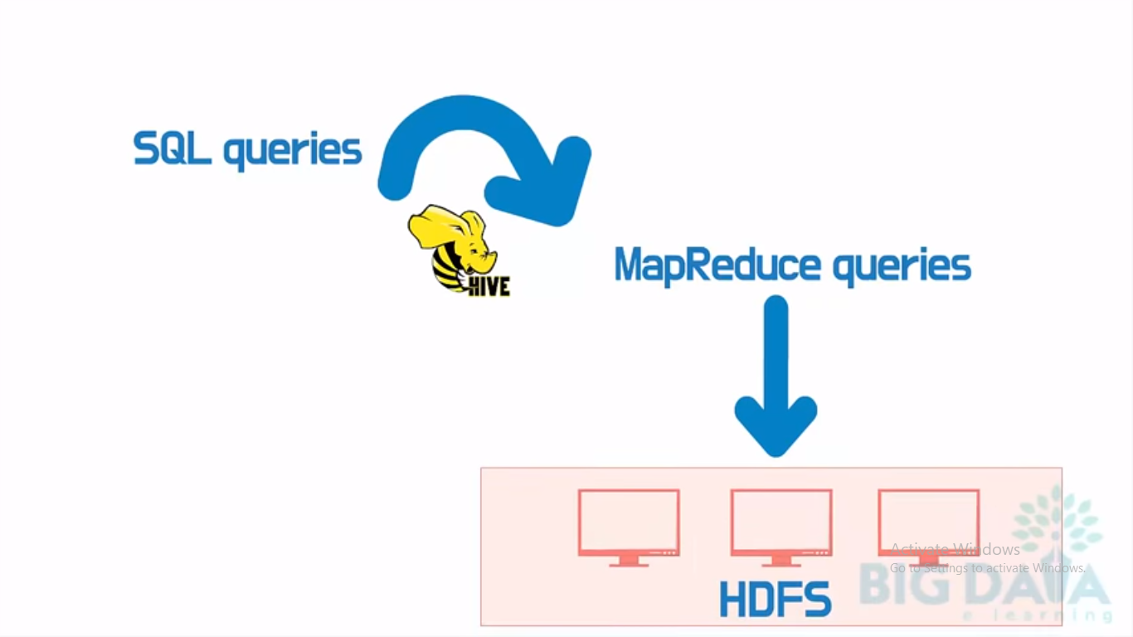
Why Hive developed?
Hive provides SQL intellect HQL or hive query langauge to query, so that users can write SQL like queries to extract, analyze and manage structure data without needing to write complex MapReduce program from Hadoop.
It is a query engine not a database bacause it doesn’t have its own storage to store data used HDFS to store data.
SQL queries converted into Mapreduce queries by hive component thats how they talk to Hadoop ecosystem and HDFS file system.

Slide 6
Hive Architecture
Key components of Hive architecture include:
Hive Metastore: Stores metadata about tables and schemas.
Hive Query Language (HQL): SQL-like language used for querying.
Execution Engine: Intract with name node and resource manager of HDFS Executes the query plans created by compiler.
Hive Driver: Manages the lifecycle of a HiveQL statement.

Slide 7
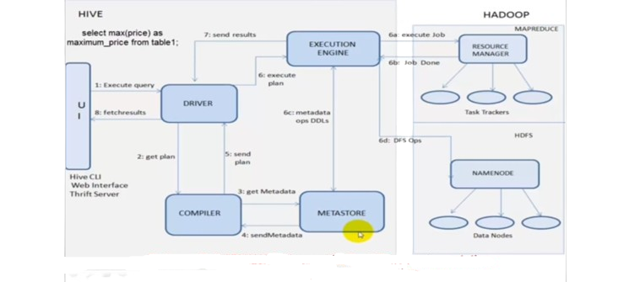
HIVE ARCHITECTURE
Notes:
thrift server means using JDBC and ODBC connection of any application with hive

Slide 8
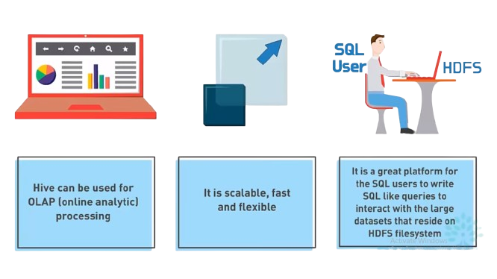
How and when hive can be used?
Notes:
Hive is utilized for OLAP due to its architecture's optimization for processing complex analytical queries on large datasets stored in distributed systems like Hadoop, enabling efficient querying, analysis, and summarization for gaining insights. Conversely, OLTP systems, which handle real-time transactional workloads with high concurrency and low-latency requirements, typically rely on traditional relational database management systems like MySQL , as they prioritize consistency, availability, and rapid response times for online transactions.
Hive achieves scalability and flexibility through its architecture, which leverages distributed computing frameworks like Hadoop. By distributing data across multiple nodes and processing queries in parallel, Hive can handle massive datasets efficiently, scaling out as data volumes grow. Additionally, its schema-on-read approach allows for flexible data modeling, enabling users to structure and organize data as needed without predefined schemas. This flexibility accommodates diverse data formats and evolving analytical requirements, empowering users to adapt Hive to various use cases and data types seamlessly.
Hive provides a SQL-like interface that translates queries into MapReduce or Apache Tez jobs, allowing users to interact with data stored in the Hadoop Distributed File System (HDFS). Through its metastore, Hive dynamically maps SQL queries to data files in HDFS, abstracting the complexities of distributed computing and enabling seamless querying of large-scale datasets.
Hive does not support OLTP. Hive supports Online Analytical Processing (OLAP), but not Online Transaction Processing (OLTP).
It does not support subqueries.
It has a high latency.
Hive tables do not support delete or update operations.

Slide 9
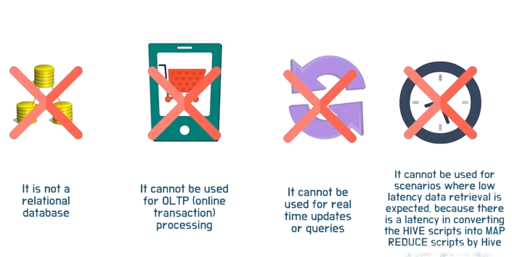
Hive cannot used for
Notes:
It's important to note Hive is not a relational database, a type of database that organizes data into tables based on related points. Rather, Hive organizes data into similar tables based on unit size
Apache Hive is mainly used for batch processing i.e. OLAP and it is not used for OLTP because of the real-time operations of the database. Instead, hbase is extensively used for transactional processing wherein the response time of the query is not highly interactive i.e. OLTP.
Apache Hive is designed for batch processing on large datasets stored in distributed file systems like HDFS, resulting in higher query latency unsuitable for real-time queries. Its architecture prioritizes scalability and fault tolerance over low-latency responses, making it inefficient for real-time applications requiring rapid query execution.

Slide 10
Data Types Suported by Hive
SIMPLE DATA TYPES | COMPLEX DATA TYPES
1. INT 2. FLOAT 3. DOUBLE 4. STRING 5. TIMESTAMP | 1. ARRAY 2. STRUCT 3. MAP

Slide 11
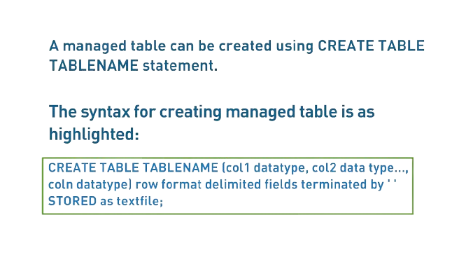
TYPES OF TABLE SUPPORTED BY HIVE
1. MANAGED TABLE (INTERNAL TABLE)
Hive fully controls both the table schema (metadata) and where data files are stored. It manages everything about the data, like creating, deleting, and organizing files.

Slide 12
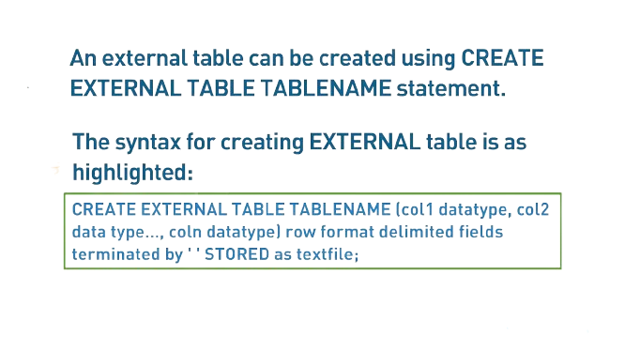
TYPES OF TABLE SUPPORTED BY HIVE
2. EXTERNAL TABLE
Hive only manages the table schema (metadata). Data files are stored outside of Hive's control, in a location like HDFS. Hive accesses these files for queries without controlling them directly.

Slide 13
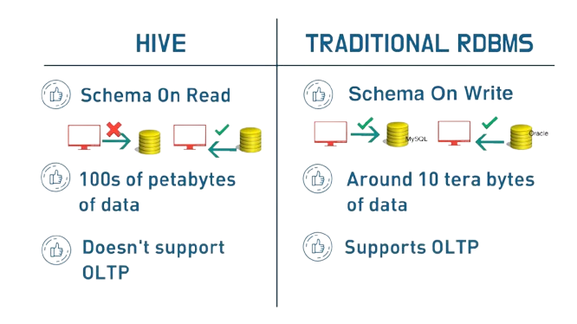
HIVE VS TRADITIONAL RDBMS
Notes:
Schema on read in Hive means that data is stored in a flexible, schema-less format, allowing users to apply structure and interpretation at query time rather than when the data is written. This approach enables Hive to accommodate diverse data formats and evolve with changing analytical requirements seamlessly.
In contrast, schema-on-write databases enforce a fixed schema at the time of data insertion, ensuring data integrity and consistency but potentially limiting flexibility in handling evolving data structures.

Slide 14
Apache Hive Integration and Data Models
Integration with Hadoop and Other Big Data Technologies

Slide 15
Hive Integration with Hadoop
Apache Hive is tightly integrated with the Hadoop ecosystem, leveraging its distributed storage (HDFS) and processing power (MapReduce, Tez, or Spark) to handle large-scale data operations efficiently.

Slide 16
Hive and Other Big Data Technologies
Hive can integrate with various big data technologies:
- **Apache HBase**: For real-time data access and storage.
- **Apache Spark**: For fast and efficient in-memory data processing.
- **Apache Kafka**: For handling real-time data streams.
- **Apache Pig**: For data transformation and analysis.

Slide 17
Hive Data Models
Hive supports a variety of data models:
- **Tables**: Structured data in a tabular format.
- **Partitions**: Logical division of tables for better query performance.
- **Buckets**: Further division within partitions to optimize query execution.

Slide 18
File Formats in Hive
Hive supports multiple file formats, enabling flexibility and efficiency in data storage and processing:
- **Text File**: Default format, simple but less efficient.
- **ORC (Optimized Row Columnar)**: Highly efficient for reading, writing, and processing data.
- **Parquet**: Columnar storage format, widely used with Spark.
- **Avro**: Supports row-based storage with rich data structures.

Slide 19
Apache Hive Installation Guide
Prerequisites and Their Importance

Slide 20
Java 8 Installation
Requirement: Apache Hive requires Java 8 to run.
Reason: Java 8 provides the necessary runtime environment for Hive. Without it, Hive cannot execute its operations.

Slide 21
Apache Hadoop Installation
Requirement: Apache Hive relies on Apache Hadoop.
Reason: Hadoop provides the distributed storage and processing framework that Hive uses to manage and query large datasets.

Slide 22
Apache Derby Installation
Requirement: Apache Derby is needed for Hive's metastore.
Reason: Derby acts as an embedded relational database to store metadata about the Hive tables, such as schemas and statistics. Without a metastore, Hive cannot keep track of the data structures.

Slide 23
Download Apache Hive
1. Visit the Apache Hive download page: https://hive.apache.org/downloads.html
2. Choose the latest stable release and download the binary tar.gz file.
3. Upload the tar.gz file to your Hadoop master node.
4. Extract file and move the extracted folder to a suitable location
5. Configure Hive environment and Hive Metastore.

Slide 24
Integrating Apache Hive with Cloudera
A Guide to Using Hive within the Cloudera Ecosystem

Slide 25
Introduction to Cloudera WITH HIVE
Cloudera Distribution of Hadoop (CDH): Cloudera’s distribution includes Hive as a core component, enabling users to leverage Hive's capabilities within Cloudera's ecosystem.
Managed Services: Cloudera offers managed services and tools for Hive, making it easier to deploy, manage, and scale Hive clusters.
Optimization and Performance: Cloudera enhances Hive's performance through integration with other technologies like Apache Impala and Kudu, which provide faster query execution and real-time analytics capabilities.

Slide 26
Cloudera Software Requirements
Cloudera Manager: This is the tool used to install, configure, and manage your Cloudera cluster, including Hive. Ensure you have the latest version compatible with your CDH version.
Cloudera Data Platform (CDP): For cloud-native deployments, ensure you are using Cloudera Data Platform, which provides the necessary tools and services for running Hive in a cloud environment.

Slide 27
HiveQL (HQL) Operations
Understanding Hive Data Types and Query Language (HQL)

Slide 28
Hive Query Language (HQL)
HQL is a SQL-like language used in Hive to query and manage large datasets. It supports various operations:
- **SELECT**: Retrieve data from one or more tables
- **INSERT**: Insert data into a table
- **UPDATE**: Update existing data in a table
- **DELETE**: Delete data from a table
- **CREATE**: Create database objects like tables and views
- **DROP**: Drop database objects like tables and views
- **ALTER**: Modify existing database objects
- **LOAD**: Load data into a table from an external source

Slide 29
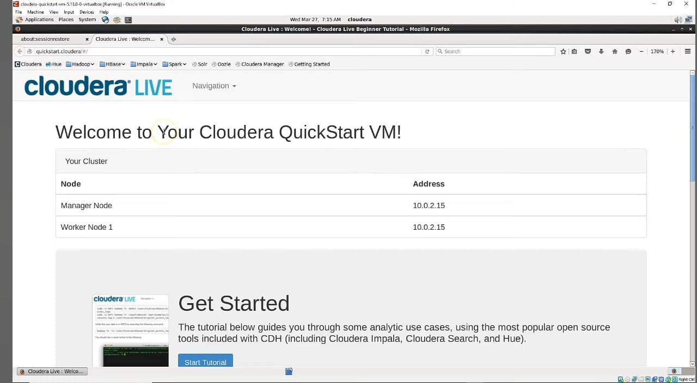
PERFORMING HIVE QL IN CLOUDERA

Slide 30
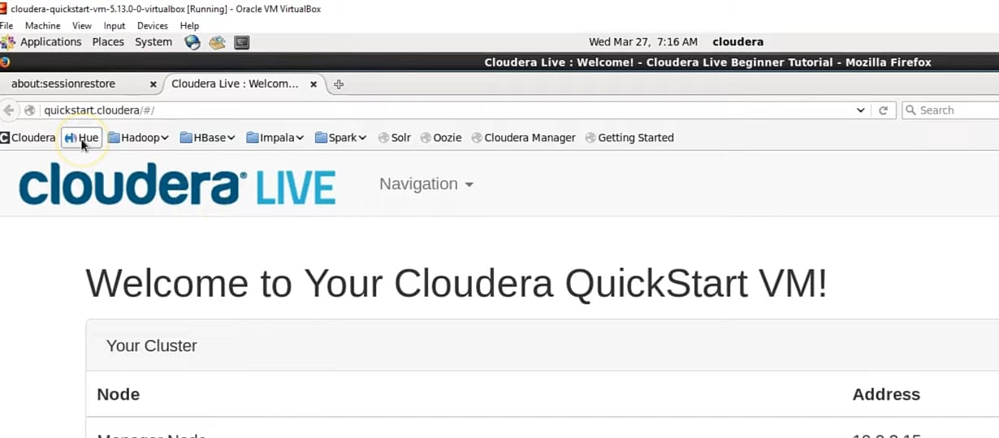
.

Slide 31
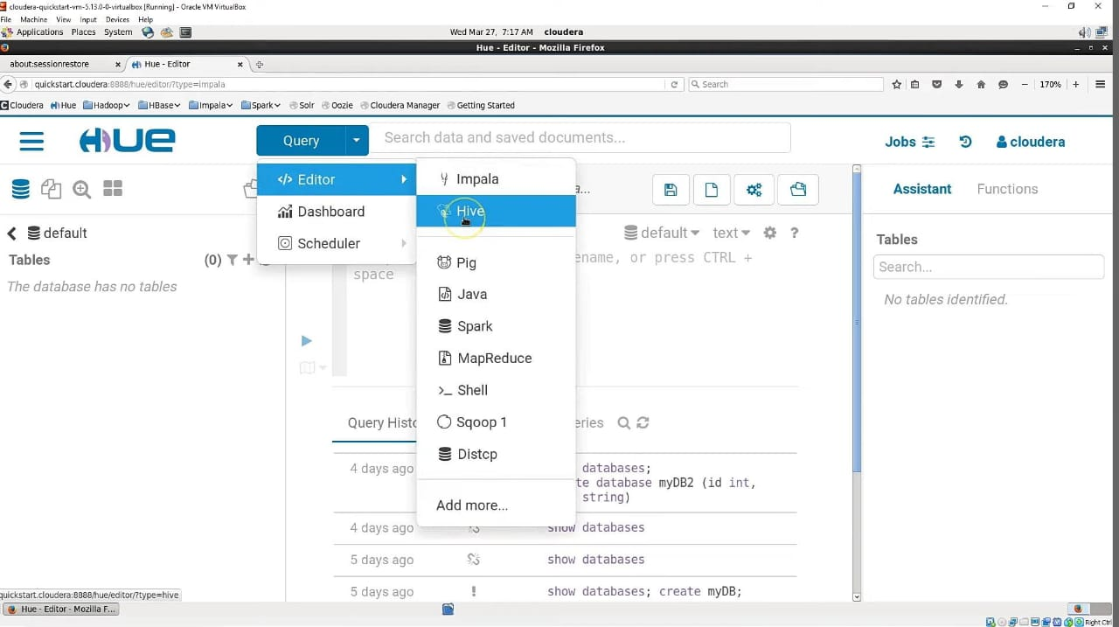

Slide 32
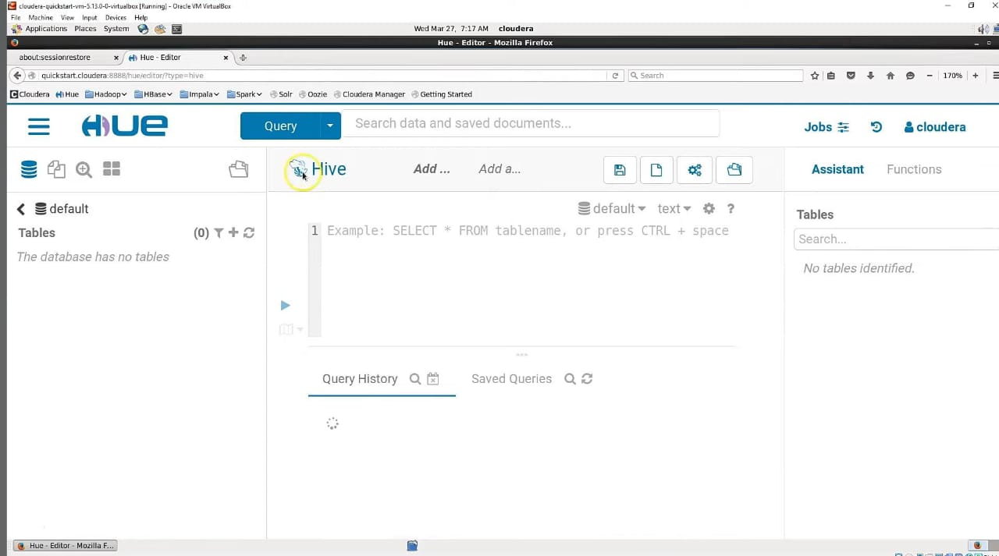

Slide 33
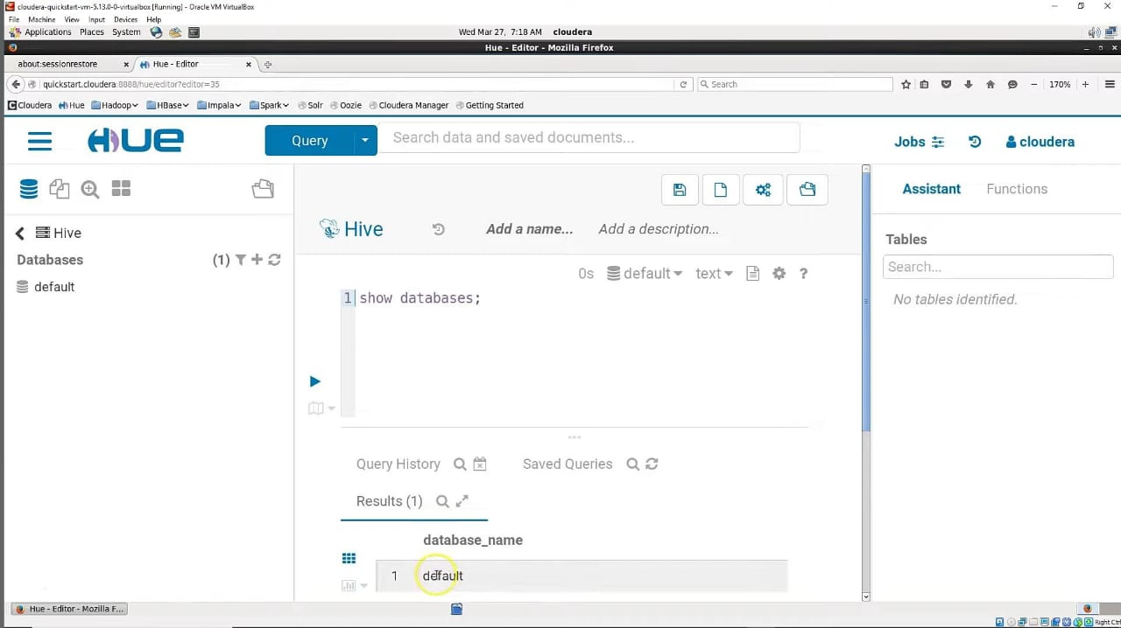

Slide 34
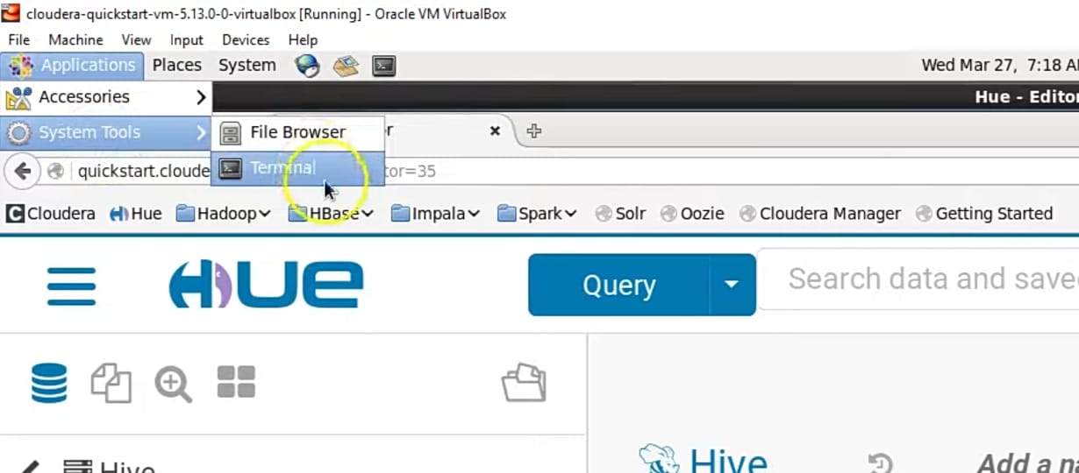
.

Slide 35
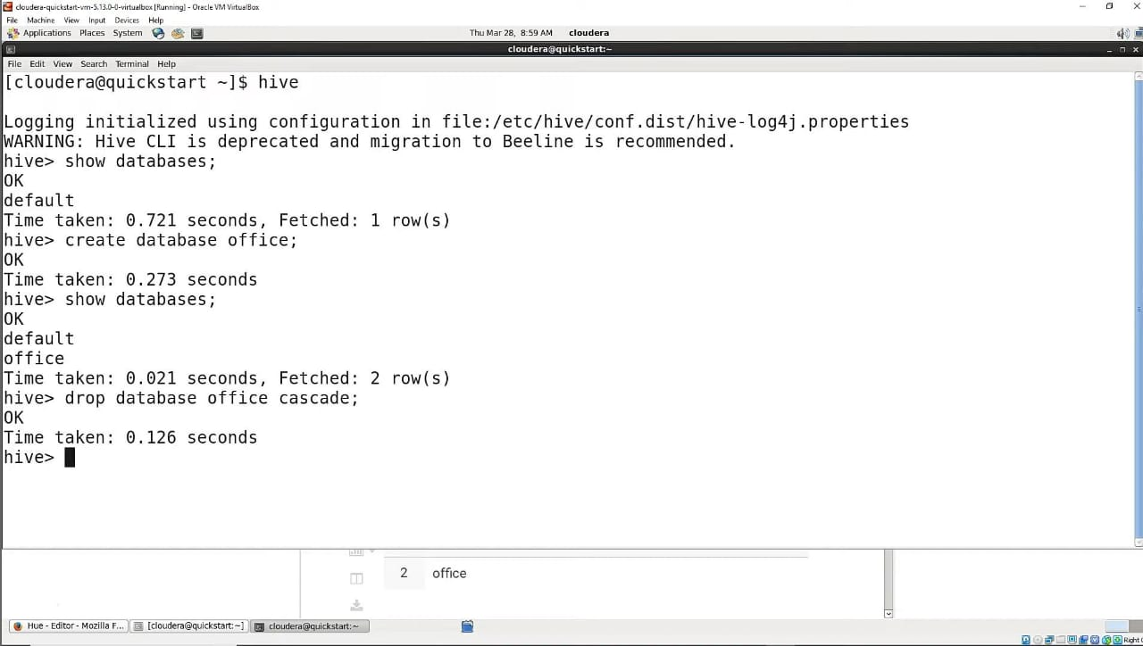

Slide 36
Hive Query Syntax
Basic SQL Queries in Apache Hive

Slide 37
Create and Drop Database
1. Create Database:
CREATE DATABASE database_name;
2. Drop Database:
DROP DATABASE database_name;

Slide 38
Create and Drop Table
1. Create Table:
CREATE TABLE table_name (
column1_name column1_type,
column2_name column2_type
)
ROW FORMAT delimited fields by’,’
LINE TERMINATED BY’\n’ STORED AS file_format;
2. Drop Table:
DROP TABLE table_name;

Slide 39
Insert and Select Data
1. Insert Data:
INSERT INTO TABLE table_name
VALUES (value1, value2);
2. Select Data:
SELECT column1, column2
FROM table_name
WHERE condition;

Slide 40
Join and Group By
1. Join Tables:
SELECT a.column1, b.column2
FROM table1 a
JOIN table2 b
ON a.common_column = b.common_column;
2. Group By:
SELECT column, COUNT(*)
FROM table_name
GROUP BY column;

Slide 41
Order By and Load Data
1. Order By:
SELECT column1, column2
FROM table_name
ORDER BY column1 DESC;
2. Load Data:
LOAD DATA INPATH 'hdfs_path'
INTO TABLE table_name;

Slide 42
Alter Table and Create View
1. Alter Table (Add Column):
ALTER TABLE table_name
ADD COLUMNS (new_column_name new_column_type);
2. Create View:
CREATE VIEW view_name AS
SELECT column1, column2
FROM table_name
WHERE condition;

Slide 43
Loading Data in Hive
Syntax and Examples

Slide 44
Load Data from Local File
LOAD DATA LOCAL INPATH 'path/to/local/file'
INTO TABLE table_name;

Slide 45
Load Data from HDFS
LOAD DATA INPATH 'hdfs_path/to/file'
INTO TABLE table_name;

Slide 46
Load Data with Overwrite
LOAD DATA INPATH 'hdfs_path/to/file'
OVERWRITE INTO TABLE table_name;

Slide 47
Load Data into a Partitioned Table
LOAD DATA INPATH 'hdfs_path/to/file'
INTO TABLE table_name
PARTITION (partition_column='value');

Slide 48
THANK YOU

